Slide 1
Power
Slides adapted form Harris – and Weste 4th Ed.

Slide 2
Outline
Power and Energy
Dynamic Power
Static Power
7: Power

Slide 3

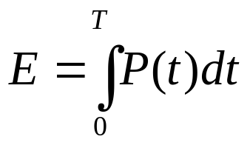
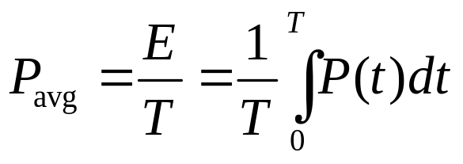
Power and Energy
Power is drawn from a voltage source attached to the V_{DD} pin(s) of a chip.
Instantaneous Power:
Energy:
Average Power:
7: Power

Slide 4
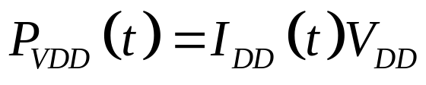
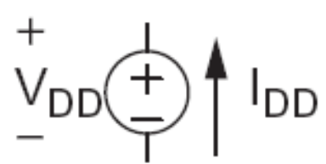
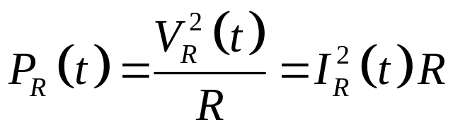
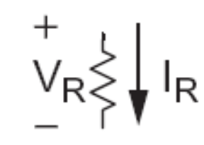
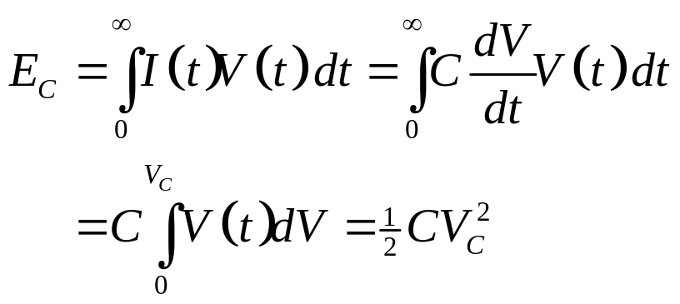

Power in Circuit Elements
7: Power

Slide 5
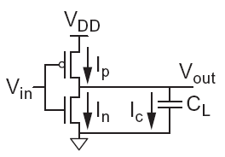

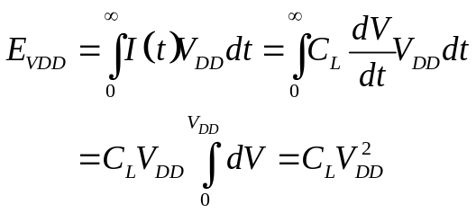
Charging a Capacitor
When the gate output rises
  Energy stored in capacitor is
  But energy drawn from the supply is
  Half the energy from V_{DD} is dissipated in the pMOS transistor as heat, other half stored in capacitor
When the gate output falls
  Energy in capacitor is dumped to GND
  Dissipated as heat in the nMOS transistor
7: Power

Slide 6
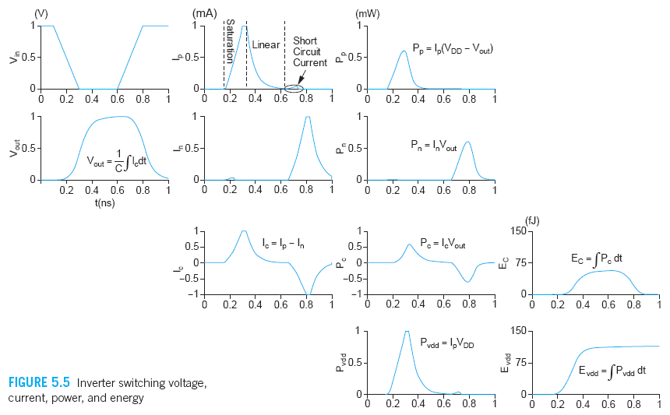
Switching Waveforms
Example: V_{DD} = 1.0 V, C_{L} = 150 fF, f = 1 GHz
7: Power

Slide 7
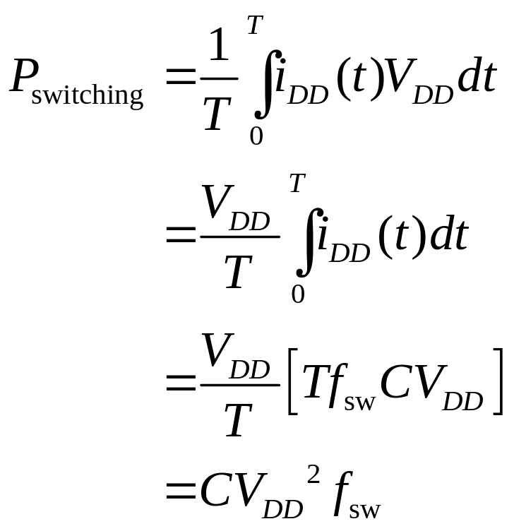
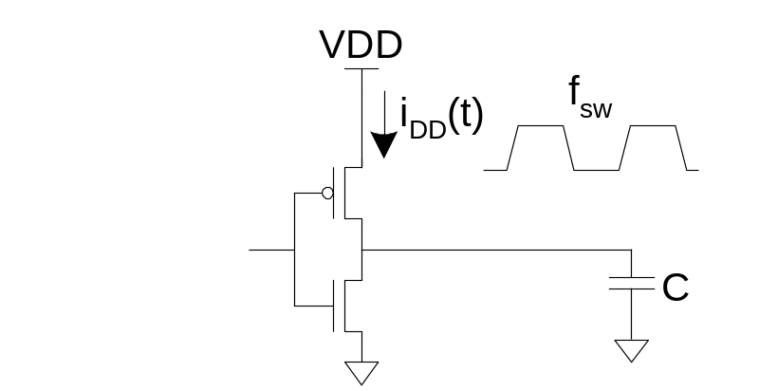
Switching Power
7: Power

Slide 8
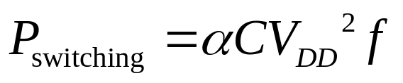
Activity Factor
Suppose the system clock frequency = f
Let f_{sw} = αf, where α = activity factor
  If the signal is a clock, α = 1
  If the signal switches once per cycle, α = ½
Dynamic power:
7: Power

Slide 9
Short Circuit Current
When transistors switch, both nMOS and pMOS networks may be momentarily ON at once
Leads to a blip of “short circuit” current.
< 10% of dynamic power if rise/fall times are comparable for input and output
We will generally ignore this component
7: Power

Slide 10
Power Dissipation Sources
P_{total} = P_{dynamic} + P_{static}
Dynamic power: P_{dynamic} = P_{switching} + P_{shortcircuit}
  Switching load capacitances
  Short-circuit current
Static power: P_{static} = (I_{sub} + I_{gate} + I_{junct} + I_{contention})V_{DD}
  Subthreshold leakage
  Gate leakage
  Junction leakage
  Contention current
7: Power

Slide 11
Dynamic Power Example
1 billion transistor chip
  50M logic transistors
    Average width: 12 λ
    Activity factor = 0.1
  950M memory transistors
    Average width: 4 λ
    Activity factor = 0.02
  1.0 V 65 nm process
  C = 1 fF/μm (gate) + 0.8 fF/μm (diffusion)
Estimate dynamic power consumption @ 1 GHz. Neglect wire capacitance and short-circuit current. Given λ = 0.025/μm
7: Power

Slide 12
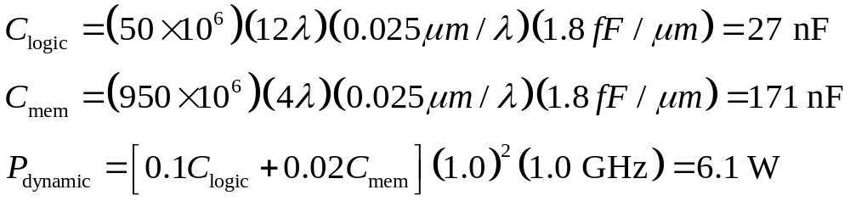
Solution
7: Power

Slide 13
Dynamic Power Reduction
Try to minimize:
  Activity factor
  Capacitance
  Supply voltage
  Frequency
7: Power

Slide 14
Activity Factor Estimation
Let P_{i} = Prob(node i = 1)
  P_{i} = 1-P_{i}
α_{i} = P_{i} * P_{i}
Completely random data has P = 0.5 and α = 0.25
Data is often not completely random
  e.g. upper bits of 64-bit words representing bank account balances are usually 0
Data propagating through ANDs and ORs has lower activity factor
  Depends on design, but typically α ≈ 0.1
7: Power

Slide 15

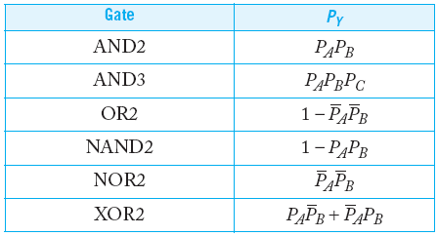
Switching Probability
7: Power

Slide 16
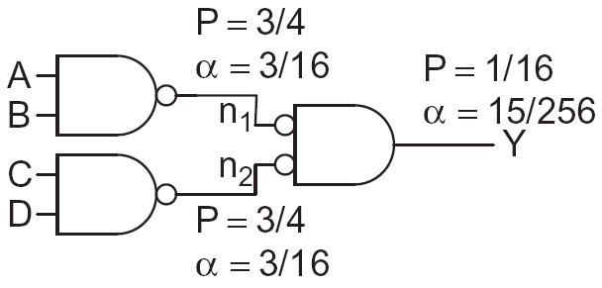
Example
A 4-input AND is built out of two levels of gates
Estimate the activity factor at each node if the inputs have P = 0.5
7: Power

Slide 17
Capacitance
Gate capacitance
  Fewer stages of logic
  Small gate sizes
Wire capacitance
  Good floorplanning to keep communicating blocks close to each other
  Drive long wires with inverters or buffers rather than complex gates
7: Power

Slide 18
Voltage / Frequency
Run each block at the lowest possible voltage and frequency that meets performance requirements
Voltage Domains
  Provide separate supplies to different blocks
  Level converters required when crossing
  from low to high V_{DD} domains
Dynamic Voltage Scaling
  Adjust V_{DD} and f according to
  workload
7: Power

Slide 19
Static Power
Static power is consumed even when chip is quiescent.
  Leakage draws power from nominally OFF devices
  Ratioed circuits burn power in fight between ON transistors
7: Power

